Slide 1
Probabilistic programming Day 1
ML vs Frequentist - Bayes Rules - PyMC3 – Distributions – Conjugate Prior – Coin Flip – Dice Rolls - Polls

Slide 2
What's up? What's next?
Data science so far, since September?
Projects
Bayesian
Markov Chains
Monte Carlo

Slide 3
This week
Monday: Probabilistic programming, probabilities, coins and dices, PyMC3.
Tuesday: Regression, linear and logistic, MCMC sampling, evaluate and debug
Wednesday: AB testing, Hierarchical models
Thursday: Time series, intermittent
Friday: Gaussian processes

Slide 5
Evaluation
Find a nice dataset (small data)
OCF, Emines
Social network
UCI, …
not already used in PyMC3 tutorials (space shuttle, mining incident, …)
Modelization and analysis project
Jupyter Notebook + data
no errors
already run

Slide 6


Data science – two protagonists
Statistical Rick
Machine Learning Morty
Studied applied math
Proves asymptotic behavior of models
Thinks carefully about assumptions
Models often linear with few parameters
Model results can be understood
Large data sets cause problems
Uses R and Python statsmodels
Studied computer science
Optimizes prediction accuracy of models
Thinks carefully about overfitting
Models non-linear with many parameters
Models are often black-box
Requires large data sets
Uses TensorFlow and scikit-learn

Slide 7





Probabilistic programming
Stan
PyMC3
Pyro
Tensorflow Probability
Edward
Greta
Infer.NET
BUGS
JAGS
Program with variables as distributions
Bayes
Understanding
Confidence intervals
Small data

Slide 8
today
Bayes Rule
Probabilistic programming
Probability distributions
Conjugate prior
Coin flip
Dice Rolls
Polls

Slide 9
Bayes formula

Slide 10
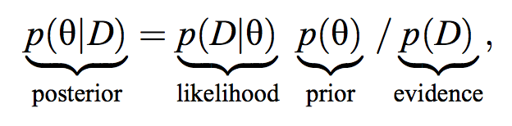
Bayes formula
http://people.duke.edu/~ccc14/sta-663-bootstrap/MCMC.html#bayesian-data-analysis
a posteriori
vraisemblance
a priori
The posterior distribution provides the most complete information that is mathematically possible about the parameter values given the data.

Slide 11
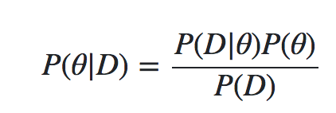
Bayes formula
https://www.quantstart.com/articles/Bayesian-Inference-of-a-Binomial-Proportion-The-Analytical-Approach
 |  | Coin Flip
P(θ) is the prior. probabilité a priori de θ (probabilité marginale) | This is the strength in our belief of θ without considering the evidence D | Our prior view on the probability of how fair the coin is.
P(θ|D) is the posterior. distribution a posteriori | This is the (refined) strength of our belief of θ once the evidence D has been taken into account. | After seeing 4 heads out of 8 flips, say, this is our updated view on the fairness of the coin.
P(D|θ) is the likelihood. fonction de vraisemblance | This is the probability of seeing the data D as generated by a model with parameter θ. | If we knew the coin was fair, this tells us the probability of seeing a number of heads in a particular number of flips.
P(D) is the evidence. probabilité marginale ou a priori de D | This is the probability of the data as determined by summing (or integrating) across all possible values of θ, weighted by how strongly we believe in those particular values of θ | If we had multiple views of what the fairness of the coin is (but didn't know for sure), then this tells us the probability of seeing a certain sequence of flips for all possibilities of our belief in the coin's fairness.

Slide 12
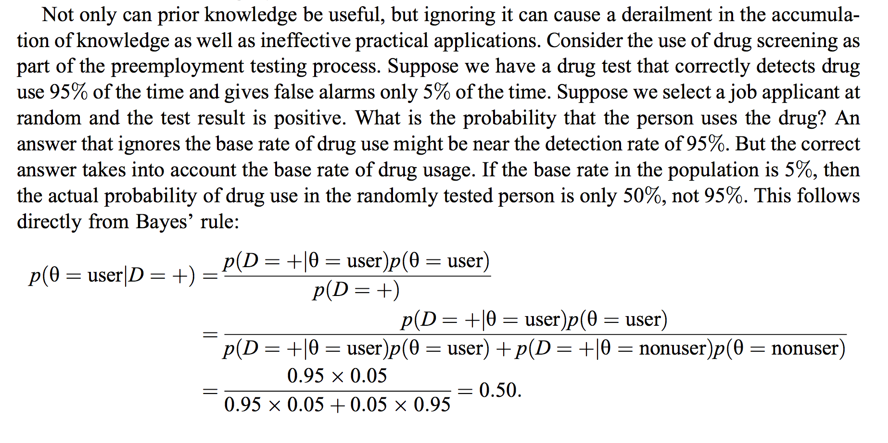
Exercice

Slide 13
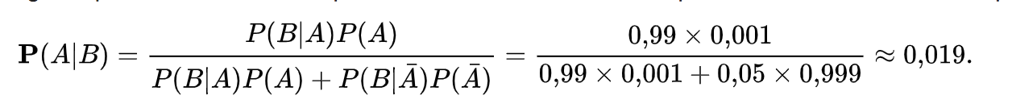
Imaginons un test extrêmement fiable :
si un patient a contracté la maladie, le test le fait remarquer, c’est-à-dire est positif, presque systématiquement, 99 % des fois, soit avec une probabilité 0.99 ;
si un patient est sain, le test est correct, c’est-à-dire négatif dans 95 % des cas, soit avec une probabilité 0.95.
Imaginons que la maladie ne touche qu’une personne sur mille, soit avec une probabilité 0,001.
Quelle est la probabilité qu’un test soit positif à tort (surdiagnostic).
Désignons par A l’événement « Le patient a contracté la maladie »
et par B l’événement « Le test est positif ».
La seconde forme du théorème de Bayes dans le cas discret donne alors :
Traduit en langage courant, cette équation signifie que « la probabilité que le patient ait réellement contracté la maladie, quand le test est positif, n'est que de 1,9 % ».
Sachant que le test est positif, la probabilité que le patient soit sain vaut donc environ : (1 − 0,019) = 0,981.
Du fait du très petit nombre de malades, en effet,
pratiquement tous les malades présentent un test positif, mais aussi
pratiquement tous les tests positifs désignent des personnes saines.

Slide 14
use case
Quantopian, predict stock market
Huge platform with backlog data

Slide 15
Thomas Wiecki - Quantopian
https://www.youtube.com/watch?v=LlzVlqVzeD8
Probabilistic programming is a new programming paradigm that provides the best of both worlds and revolutionizes the field of machine learning. Recent methodological advances in sampling algorithms like Markov Chain Monte Carlo (MCMC), as well as huge increases in processing power, allow for almost complete automation of the inference process. Probabilistic programming thus greatly increases the number of people who can successfully build statistical models and machine learning algorithms, and makes experts radically more effective. Data scientists can create complex generative Bayesian models tailored to the structure of the data and specific problem at hand, but without the burden of mathematical tractability or limitations due to mathematical simplifications. This talk will provide an overview of PyMC3, a new probabilistic programming package for Python featuring intuitive syntax and next-generation sampling algorithms.
Original Slides https://docs.google.com/presentation/d/1QNxSjDHJbFL7vFwQHHheeGmBHEJAo39j28xdObFY6Eo/edit

Slide 16
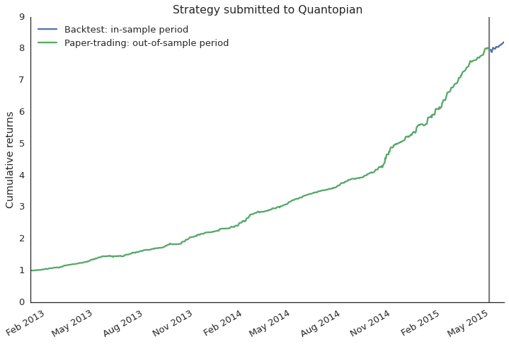
How to select strategies for fund?
paper trading
backtest
Notes:
Most historical backtest performances look amazing, they almost never lose money
Then however, when you set it live and deploy it with capital a common failure mode is that it does not seem to perform as the backtest suggested
Problem is, it is very easy to overfit the backtest so that it only works on historical data but not going forward

Slide 17
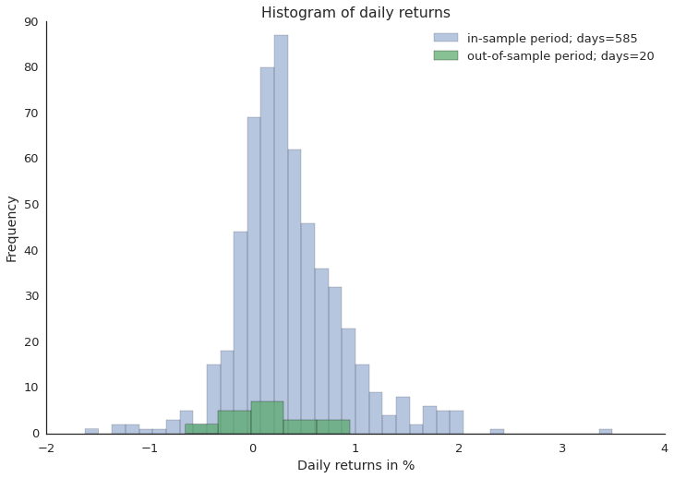
Does out-of-sample data support backtest?
Notes:
Another way to look at that same data is just as a histogram of daily returns
Here the question becomes, do the out-of-sample returns come from the same distribution as the in-sample returns
Difficult problem because out-of-sample data is always scarce and returns are generally noisy
Now how would you solve that problem? There are several approaches that a data scientist might follow.

Slide 18
Blackbox Machine Learning
Classifier
Data
Predictions
Train classifier to distinguish between distributions.
Classification framework not well suited.
Blackbox: Not good at conveying what was learned.
Notes:
It is fair to say that machine learning has revolutionized data science and is definitely the go-to choice in a lot of cases. But how might we apply it in this specific case?
One possibility would be to try and train a classifier and if it is able to differentiate between these two distributions in cross-validation we would assume that the backtest is overfit.
Now you will probably say that machine learning is just not the right tool for the job in this case and that is precisely the point I am trying to convey.
Most machine learning algorithms are very static in what they do so to apply them we would have to change our problem and shoe-horn it into this framework: “If your only tool is a hammer, everything starts to look like a nail”. This is actually very common.
Another problem with this approach is that we don’t really have a measure of confidence in our answer.
Lastly, these blackbox algorithms are often bad at conveying what they have learned from the data. And that might be fine if you only care about prediction but if you actually want to learn something from your data this tool is less well suited.

Slide 19
Frequentist Statistics
Hypothesis
Test
Data
p-value
Gray box - implicit assumptions:
normality (violated here, daily returns have heavy tails)
Hard to change assumptions.
p-value is not the probability we care about.
Notes:
Alternatively, we could use frequentist statistics which is much better suited for this type of problem
Usually, you run a hypothesis test like the t-test which produces a p-value
While tempting, this p-value is actually not the probability that the two distributions are different. Unfortunately I don’t have enough time to go into this subtlety but it has far reaching implications.
In addition, there are various implicit assumptions, for example, the t-test assumes your data to be normally distributed which unfortunately is not the case for daily returns as they are known to have much heavier tails or extreme events which you often observed in the market and which are very meaningful.
And unfortunately changing these assumptions would require us to completely rederive the test so frequentist statistics is very inflexible

Slide 20
What we want
Performance
Reliability and robustness: no unrealistic assumptions
Interpretability – easy to understand: no p-values, no NULL hypothesis, no black box

Slide 21
Probabilistic Programming
Custom
Probabilistic
Model
Data
Probabilities
Build custom model in code (open box)
Automatic inference with MCMC
Bayesian (actual probabilities, priors)
Notes:
Now probabilistic programming allows us much greater flexibility by providing us with a toolbox to build a model specifically tailored to the problem we’re trying to solve
The real power of that approach is that we can specify arbitrarily complex models in computer code and then use very general inference algorithms called Markov chain Monte Carlo to fit them to data
Moreover, probabilistic programming implements Bayesian statistics which actually gives us the probabilities we care about unlike frequentist statistics does.
So what is a good way to think about creating such a model?

Slide 22
For real
Choose the distribution of
our priors
our target (posterior)
Define the relation between the target and the priors
Sample the Evidence

Slide 23
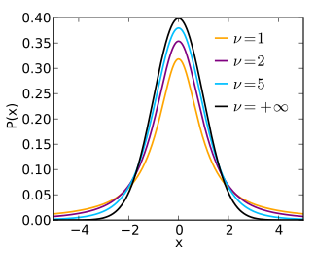
Modeling financial returns
Latent causes
(Parameters)
location
scale
tails
Distribution
of Data
Inference: Bayes Formula
probability of parameters given data
Student-T Distribution
Observed Data
Notes:
Coming back to our original problem of comparing in and out-of-sample returns we can build a specific model that assumes returns to be T-distributed rather than normal.
Besides the location and scale parameter, or mean and variance, this distribution has a third parameter that controls how much mass there is in the tails to account for these extreme events we frequently observe in the stock-market.

Slide 24

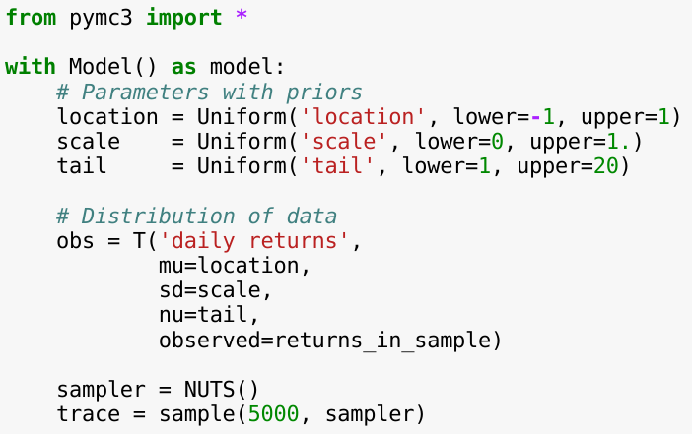
Probabilistic Programming with PyMC3
location
scale
tails
Model specification
T-Distribution
Inference
Notes:
Lets look at how this model would look like in PyMC3 -- a new probabilistic programming framework written in Python and which I helped develop.
After importing and setting up the model context we have to define the unobservable parameters of our model.
As this is a Bayesian framework we have to specify priors which allow me to define my belief about possible parameter values before I have seen any data. Here I’m just assigning equal belief in a fixed interval but you have many choices here. Informative priors are very powerful to constrain the model and apply regularization.
Once the parameters are defined we have to relate them to the distribution of the data which is T as we said before.
Note how the first parameter is a name I can give to the distribution and how the three parameters of the T distribution connect up with the definition of the parameters above.
Using the observed keyword argument we pass in our observed data -- which is just an array of the daily returns of either the in or out-of-sample returns. We will run this model on the two data sets independently.
So far this code only specifies the model and under the hood builds up a compute graph in theano which we then just-in-time-compile to C for speed.
So that part is the model specification.
To actually run MCMC sampling to infer the parameters we instantiate a sampler object. Here we are using the NUTS sampler which is a very recent development that revolutionized probabilistic programming as it this sampler works on models that are way more complex than this one.
We then draw 5000 samples from the so-called posterior which will contain likely values of the parameters given the data.

Slide 25
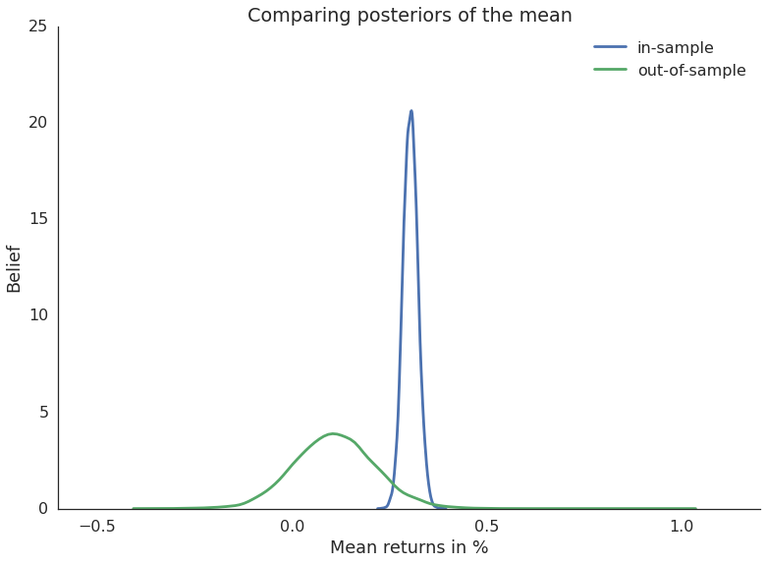
Comparing mean returns
in-sample vs out-of-sample
Notes:
Now to answer our original question, whether the out-of-sample period matches what was suggested by the backtest we can check if the mean of the two distributions is significantly different.
Here we just plot the posterior of the mean returns. It is important to note that this is *not* the returns-distribution itself, but rather our belief in the mean of the returns-distribution. Because we are doing Bayesian statistics, the mean is not a single number but actually a probability distribution that tells us how likely different mean values are. Intuitively, the wider the distribution the more uncertainty we have so you can see that with only a few days of out of-sample data our uncertainty in the mean of that period is much higher than for the backtest period for which we consider a much smaller parameter range as likely.
Given these posteriors we can now ask statistically meaningful questions like what is the probability that the mean returns of the in-sample period is smaller than the out-of-sample period.
3.34% which is very low so in this case we are fairly certain that the backtest is overfit on historical data.

Slide 26
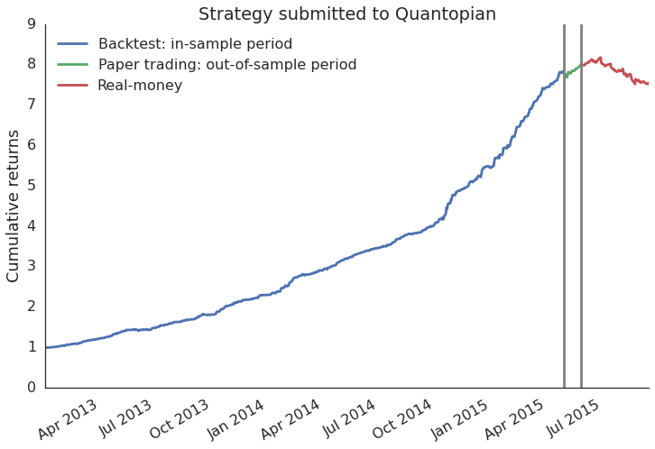
What actually happened
Winner of our trading competition so we deployed real money to that strategy
Notes:
With probabilistic programming we now have a tool to alert us to these problems much sooner so that this won’t happen again.

Slide 27
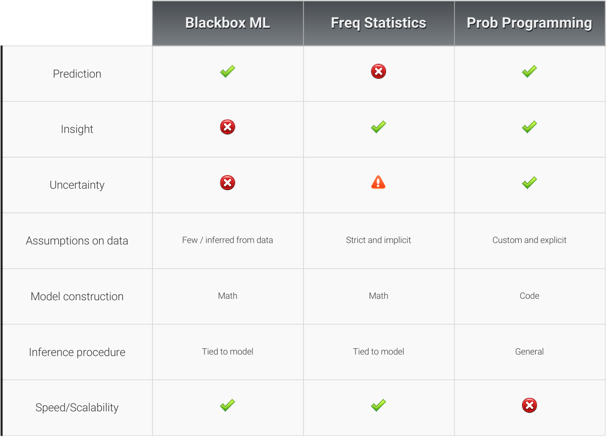
Notes:
To summarize I wanted to give a quick side-by-side comparison of the various approaches.
I showed that probabilistic programming is well suited to provide insight into data as well as do prediction, just like machine learning.
Since we’re using Bayesian statistics we are tracking uncertainty in a more direct way than what frequentist statistics offers.
Finally, the real power comes from the fact that we can build custom models in code and have a very general inference algorithm that works transparently on almost any model you throw at it.
All this, however, comes at increased computational cost. But with better samplers and faster computers this is becoming less of a problem. Personally, if I had to chose between insight and computation time, I’d always chose insight.

Slide 28
Frequentist vs Bayesian

Slide 29
Frequentist vs Bayesian
Hypothèses
Pour un nombre infini d'échantillons
theoreme des grands nombres
E[f] = 1/n ∑f_i
=> frequentist retourne un nombre, une estimation
"Frequentists, who ascribe to the more classical version of statistics, assume that probability is the long-run frequency of events (hence the name). For example, the probability of plane accidents under a frequentist philosophy is interpreted as the long-term frequency of plane accidents"
“Bayesian inference is simply updating your beliefs understanding after considering new evidence.”
=> Bayesian retourne une proba
MLE-vs-Bayes.pdf

Slide 30
Frequentist
In frequentist statistics, we assume the parameter(s) of interest are fixed constants. We focus on computing the likelihood:
Prob(Data | Parameter)
the probability we see the observed set of data points given the parameter of interest.
In Bayesian statistics:
uncertainty surrounding our parameter(s) of interest, and we mathematically capture our priori uncertainty about these parameters in a prior distribution, formally represented as
Prob(Parameter).
We focus on computing the posterior distribution:
Prob(Parameter | Data)
representing our posteriori uncertainty surrounding the parameter of interest after we have observed data.
we know that the posterior Prob(Parameter | Data) is proportional to Prob(Data | Parameter)·Prob(Parameter),
the likelihood multiplied by the prior distribution.

Slide 31
Bayesian analysis is the mathematically normative way to reallocate credibility across parameter values as new data arrive.
“Bayesian inference is simply updating your beliefs after considering new evidence.”
“ Frequentists, who ascribe to the more classical version of statistics, assume that probability is the long-run frequency of events (hence the name). For example, the probability of plane accidents under a frequentist philosophy is interpreted as the long-term frequency of plane accidents”

Slide 32
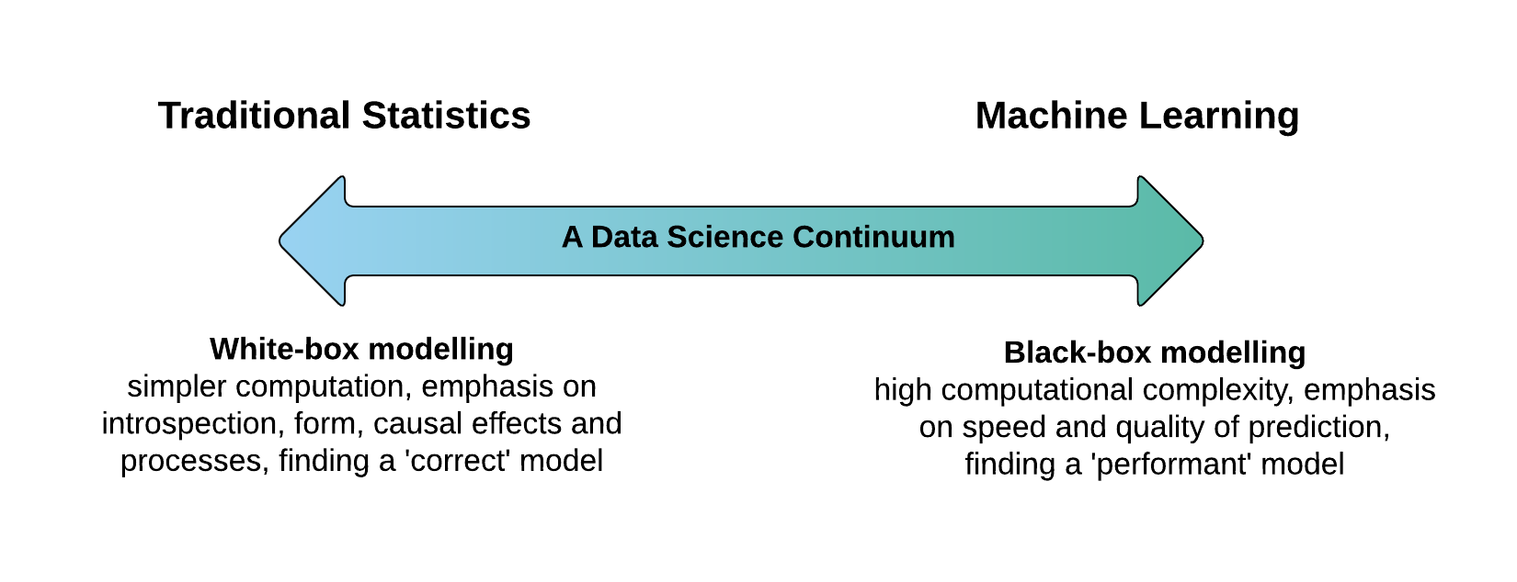
https://blog.applied.ai/bayesian-inference-with-pymc3-part-1/
On the left hand side, the tools and techniques of the StatisticianOn the right hand side, the tools and techniques of the InformaticianSimple feature engineering, simple classifications/regressions and introspectable 'white-box' models easily expressed in mathematical notation.Computer systems to store, process and retrieve information, complex data processing and 'black-box' models to learn from data.Models are intentionally simpler and may have closed-form expressions easier to compute. They may be created according to known physical laws and/or scientific assumptions about the outside world.The models may also have a simple form, but typically require heavy computation and have high overall complexity due to combinatorics, non-linear transforms, local optimisations, stochasticity and ensemble effects.(Generalized) Linear Models, Linear Compression (PCA / SVD), Decision Trees etc.Random Forests, Support Vector Machines, (Deep) Neural Nets, Non-linear transforms etc. DataScience-Continuum---New-Page.png

Slide 33
Frequentist vs Bayesian
Analogie du code qui a des bugs:
Mon code a souvent des bugs [prior]
Mon code passe tout les tests [evidence]
Est ce que mon code est sans bugs?
Reponses:
=> frequentists: oui
=> bayesian: probablement oui (p = 0.8 par exemple)
ML: besoin d'une base de scripts, de leur performances face au tests et s'ils ont des bugs au final ou non

Slide 34
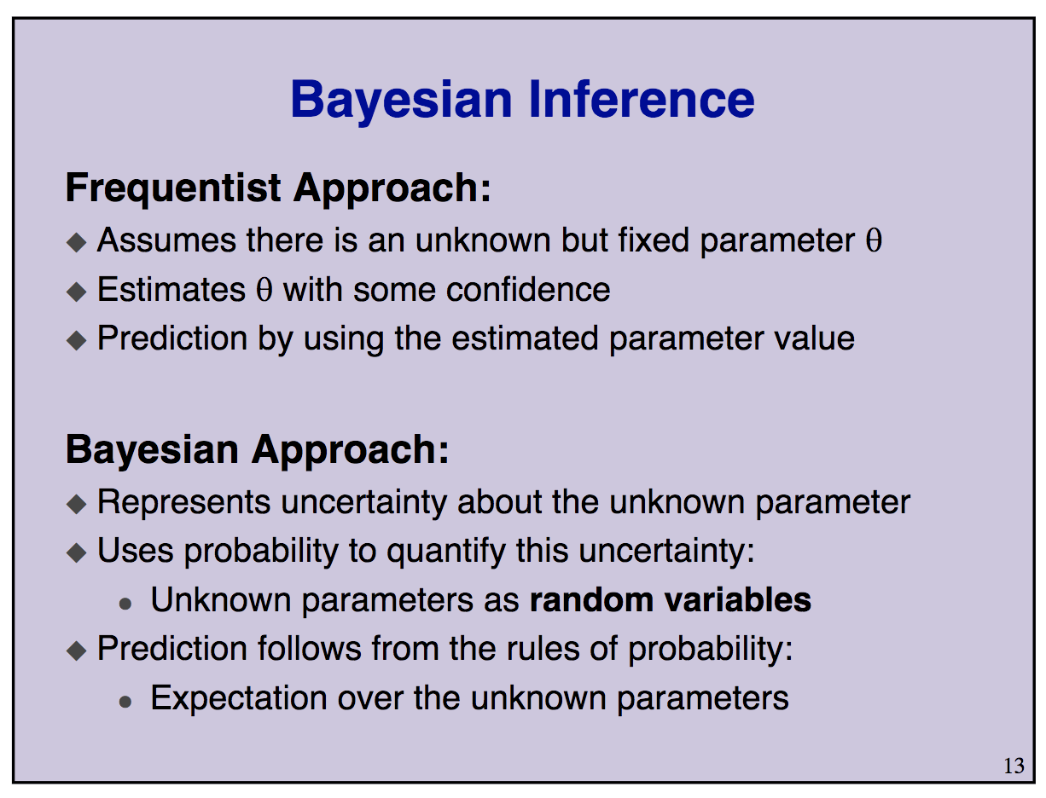
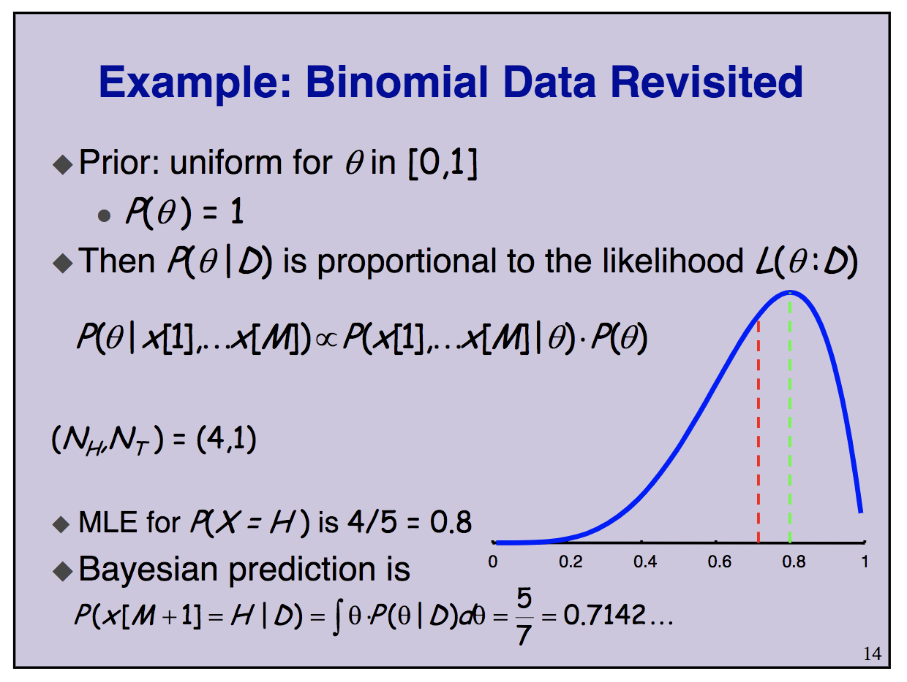
MLE and Bayesian prediction converge to the same value as the number of training data increases

Slide 35
Pile ou face
Biais d'une piece de monnaie
Data : 0,0,0,1,1,0,0,1,0,0
Bernoulli(p)
Binomiale = N * Bernoulli = p(x = k) = (n/k) (1-p)^k p ^(N-k)
Ici k = 3, N = 10
Priori : Ber(p)
Posteriori : P(p / Data) = P(data / p) P(p) / P(data)

Slide 36
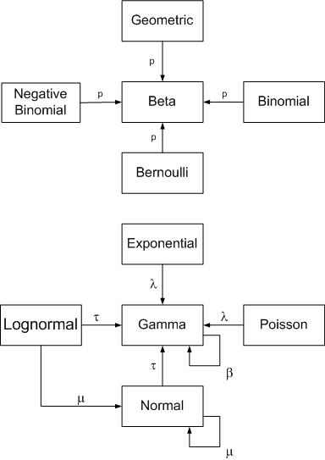
Approche bayesienne: Théorie et Pratique
Expression du posterieur non dérivable
=> la distribution a posteriori est obtenue par échantillonage des données observées
On connait l'expression de la distribution posteriori:
ex: Conjugate prior
Probabilistic programming

Slide 37
Probabilistic programming
Obtenir une distribution des variables estimées (posterior)
Utiliser nos connaissances a-priori des variables aléatoires (prior) pour ameliorer le modele et les prédictions
Définir des fonctions de cout adaptées au problème. Au dela de RMSE, AUC, …
Modele hierarchiques
No need for a lot of data

Slide 38
PyMC3
Exemple with a coin flip, N bernoulli(p) trials
data = st.bernoulli.rvs(p, n = #trials)
Model the prior
p = pm.Uniform('p', lower = 0, upper = 1)
Model the observed data (likelihood)
y = pm.Binomial('y', n = #trials, p = p, observed = data)
Sample the posterior distribution
trace = pm.sample(<Number of samples>, step = <Sampler>, …. )

Slide 39

My motivations ?
Better at answering business questions
Around for a long time but really shiny
Make math great again
Beyond the deep learning hype
But really levelling up to:

Slide 40
PyMC3

Slide 41

Probabilistic Programming framework for Python, FOSS
Specify arbitrary models in code by plugging probability distributions into each other
Intuitive model specification syntax
For example: x ~ N(0,1) translates to x = Normal('x', 0, 1)
Inference Button: Automatic and powerful inference for any model
Sampling algorithms (MCMC): More accurate, but slower
Variational inference (ADVI): Less accurate, but much faster
Thin layer on top of Theano (deep learning library like TensorFlow):
Computation optimization and dynamic C and GPU compilation

Slide 42
Probabilistic Programming Language
Cutting edge MCMC samplers and variational inference techniques
started in 2003
based on Theano: from Yoshua Bengio Labs, efficient gradients
https://docs.pymc.io/history.html#history

Slide 43
PP = Bayes + Sampling
Bayes
Prior, Posterior, Likelihood
Sampling
Sample the posterior distribution
Bootstrap
MCMC: Monte Carlo Markov Chain
random walk
Metropolis Hastings
Gibbs Sampling
NUTS

Slide 44
Qui utilise PP
Quantopian, Thomas Wiecky Financial
…
Chris Fonnesbeck
@fonnesbeck
Uber http://pyro.ai
Stan, …

Slide 45
There are many open-source software libraries for Bayesian modelling and inference, and it is instructive to look into the inference methods that they do (or do not!) implement.
Stan
PyMC3
Pyro
Tensorflow Probability
Edward
Greta
Infer.NET
BUGS
JAGS

Slide 46
Creating distributions with PyMC3
Let's get started with some code

Slide 47
Install PyMC3 & Theano
conda install …

Slide 48
Creating distributions with PyMC3
with pm.Model() as generate_model:
alpha = pm.Uniform('alpha', lower = 0, upper = 100)
x = pm.Normal('x', mu = 10, sd = 2)
y = pm.Deterministic('y', alpha + 5 * x)
gtrace = pm.sample(5000, step=pm.NUTS())
X = pd.DataFrame( columns = ['x','y'] )
X['x'] = gtrace['x']
X['y'] = gtrace['y']
n_samples = X.shape[0]
fig, ax = plt.subplots(1,1, figsize = (12,6))
plt.hist(gtrace['x'], bins = 100, label = 'x', alpha= 0.8)
plt.hist(gtrace['alpha'], bins = 100, label = 'alpha', alpha= 0.5)
plt.hist(gtrace['y'], bins = 100, label = 'y', alpha= 1)
plt.legend()
plt.show()
Exemple: follow
Ch2_MorePyMC_PyMC3
All PyMC3 variables have an initial value (i.e. test value). param.tag.test_value
set the initial value: parameter = pm.Exponential("poisson_param", 1.0, testval=0.5)
This can be helpful if you are using a more unstable prior that may require a better starting point.

Slide 49
https://pymc3.readthedocs.io/en/stable/notebooks/posterior_predictive.html
Generate a distribution
Look at several distributions
Programming with distributions
several functions: traceplot, sample,
data = np.random.randn(100) with pm.Model() as model: mu = pm.Normal('mu', mu=0, sd=1, testval=0)
sd = pm.HalfNormal('sd', sd=1)
n = pm.Normal('n', mu=mu, sd=sd, observed=data)
trace = pm.sample(5000)

Slide 50
Probabilities

Slide 51
Distributions
For a given Random Variable X with events in D. And k a value in D.
Probability Mass Function: The probability X equals a certain value k
p(X = k)
Cumulative distribution function: The probability X < k
P(X < k)

Slide 52
Conjugate prior

Slide 53
Conjugate prior
closed form likelihood when prior is Guassian, Beta, …
Otherwise need to estimate the likelihood integral over all dimensions
=> Monte Carlo
=> Monte Carlo Markov Chain
Une loi a priori conjuguée sur θ pour un modèle statistique donné si la loi a posteriori sur θ appartient à la même famille de la loi a priori.
https://rstudio-pubs-static.s3.amazonaws.com/123385_7a2370d74be24f3caeaca9bc991a3026.html

Slide 54
Conjugate prior
In Bayesian probability theory, if the posterior distributions p(θ | x) are in the same probability distribution family as the prior probability distribution p(θ), the prior and posterior are then called conjugate distributions, and the prior is called a conjugate prior for the likelihood function
https://www.johndcook.com/blog/conjugate_prior_diagram/

Slide 55
Beta-Binomial
While the Binomial distribution represents the probability of success in a series of Bernoulli trials, the Beta distribution here represents the prior probability distribution of the probability of success for each trial.
the probability pp of a coin landing on head is modeled to be Beta distributed (with parameters α and β), while the likelihood of heads and tails is assumed to follow a Binomialdistribution with parameters nn (representing the number of flips) and the Beta-distributed pp, thus creating the link.
p∼Beta(α,β)
y∼Binomial(n,p)

Slide 56
Beta distribution
Beta(1,1), which corresponds to the Uniform distribution

Slide 57
Why Is A Beta Prior Conjugate to the Bernoulli Likelihood?
https://www.quantstart.com/articles/Bayesian-Inference-of-a-Binomial-Proportion-The-Analytical-Approach

Slide 58
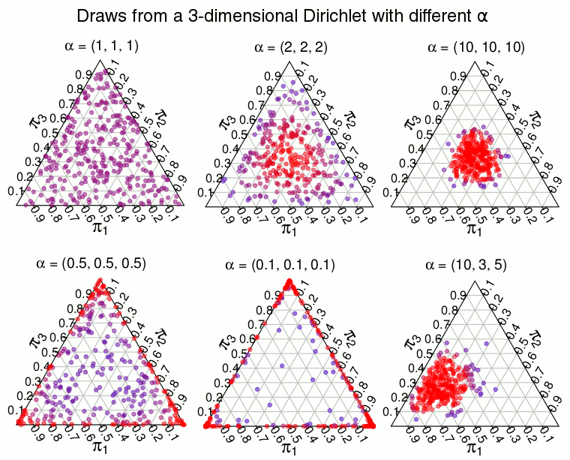
Dirichlet
A 2-dimensional Dirichlet is the same as a Beta distribution
A 2-dimensional Dirichlet is the same as a Beta distribution and is defined on the line where π1+π2π1+π2 is always 1, the 3-dimensional Dirichlet is defined on the triangle where π1+π2+π3π1+π2+π3 is always 1, and so on. A KK-dimensional Dirichlet has KK parameters α=(α1,…,αK)α=(α1,…,αK) where the expected proportion of, say, π1π1 is α1/∑α1..Kα1/∑α1..K . The higher the sum of all the ααs, the more the distribution concentrates on the expected proportion. If instead ∑α1..K∑α1..K approaches 0, the distribution concentrates on points with few large proportions.

Slide 59
Coin Flip

Slide 60
Inference on a binomial proportion
Engineering: Estimating the proportion of aircraft turbine blades that possess a structural defect after fabrication
Social Science: Estimating the proportion of individuals who would respond "yes" on a census question
Medical Science: Estimating the proportion of patients who make a full recovery after taking an experimental drug to cure a disease
Corporate Finance: Estimating the proportion of transactions in error when carrying out financial audits
Data Science: Estimating the proportion of individuals who click on an ad when visiting a website

Slide 61
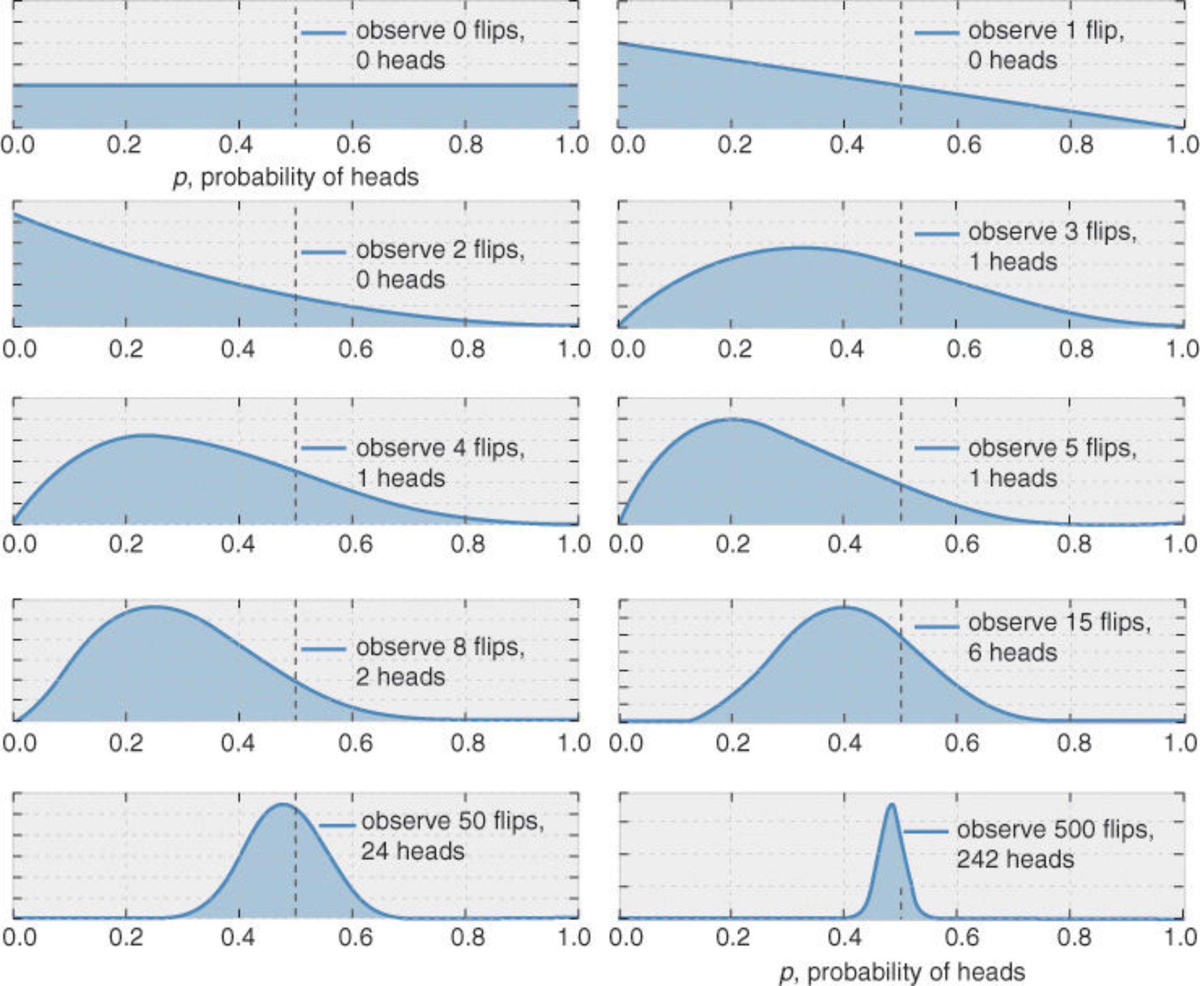
Coin flip
Estimer Bernoulli(p) en fonction d'une serie de coin flip
plus on a de data, meilleure est l'estimation
MLE: |H| / |Flips|
see Ch1_Introduction_PyMC3.ipynb for code to generate left plot

Slide 62
PP in action: coin flip
From data of N trials (flips), can we infer p(X = head) ?
data = st.bernoulli.rvs(p, n = #trials)
Model the prior
p = pm.Uniform('p', lower = 0, upper = 1)
Model the observed data (likelihood)
y = pm.Binomial('y', n = #trials, p = p, observed = data)
Sample the posterior distribution
trace = pm.sample(<Number of samples>, step = <Sampler>, …. )

Slide 63
Coin flip: MLE
Max Likelihood
MLE(θ) = P(x1,x2,...,xn|θ)
see https://alfan-farizki.blogspot.com/2015/07/pymc-tutorial-bayesian-parameter.html for equations
Stat: CHi-test

Slide 64
Coin Flip - Bayes
P(θ|x1,x2,...,xn)∝P(θ)P(x1,x2,...,xn|θ) Proportionel au MLE
Estimator de Bayes
θ̂ =E[θ|x1,x2,...,xn]
When N -> INF
Bayes ~ MLE
Hierarchical Bayesian Model
Analytical approach
Bayesian Inference of a Binomial Proportion - The Analytical Approach
https://www.quantstart.com/articles/Bayesian-Inference-of-a-Binomial-Proportion-The-Analytical-Approach

Slide 65
Coin flip with PyMC3
Code structure
Modelisation
theta ~ Uniform
=> TD: reutiliser le code ne modifiant la modelisation de theta. Prendre Beta distribution
Comparer avec MLE
voir partie appliqué de
https://www.quantstart.com/articles/Markov-Chain-Monte-Carlo-for-Bayesian-Inference-The-Metropolis-Algorithm

Slide 66
Errors
The number of effective samples is smaller than 10% for some parameters.
A low number of effective samples is usually an indication of strong autocorrelation in the chain
Use an efficient sampler like NUTS inseatd of Metropolis
Tweak the acceptance probability

Slide 67
pm.summary
eff_n, which stands for effective number of samples

Slide 68
Gaussian

Slide 69
Exercice
Generate N(mu, sigma)
Estimate mu and sigma
prior mu, sigma : uniform
likelihood: N(mu, sigma, observed = data)
sample

Slide 70
Dice rolls

Slide 71
Multinomial

Slide 72
Dirichlet

Slide 73
Dice rolls
the Multinomial (i.e. multiple choices) distribution is a generalization of the Binomial distribution (i.e. binary choice), the Dirichlet distribution is a generalization of the Beta distribution.
That is, while the Beta distribution models the probability of a single probability p, the Dirichlet models the probabilities of multiple, mutually exclusive choices, parameterized by a which is referred to as the concentration parameter and represents the weights for each choice
θ∼Dirichlet(a)
y∼Multinomial(n,θ)

Slide 74
Polls - TD

